Slide 1


Data Analytics
For
Social
Buzz

Slide 2


Today's agenda
Project recap
Problem
The Analytics team
Process
Insights
Summary

Slide 3


Social Buzz is a fast growing technology unicorn that need to adapt quickly to it’s globle scale.
Accenture has begun a 3 month POC focusing on these tasks:
An audit of Social Buzz’s big data practice
Recommendations for a successful IPO
Analysis to find Social Buzz’s top 5 most popular categories of content
Project Recap

Slide 4


Problem
Over 100000 posts per day
36,500,000 pieces of content per year!
But how to Capitalize on it when there is so much?
Analysis to find Social Buzz’s top 5 most popular categories
of content

Slide 5



ANDREW FLEMING
Chief Technology Architect
The Analytics team
MARCUS ROMPTON
Senior Principal
GOURAV SINHA
Data Analyst

Slide 6

Process
1
Data Understanding
2
Data Cleaning
3
Data Modelling
4
Data Analysis
5
Uncover Insights

Slide 7


1368
1368
Insights
16
Unique Categories
1368
Reactions to “travel” posts
August
Month with
most posts - 1612

Slide 8
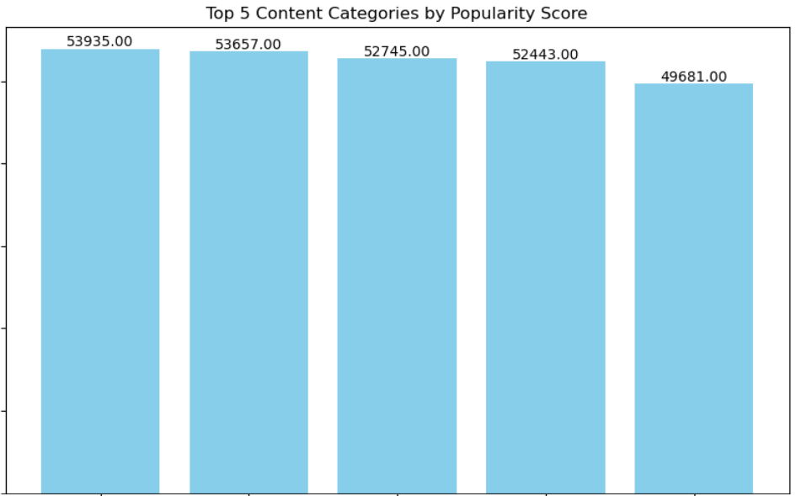

Slide 9
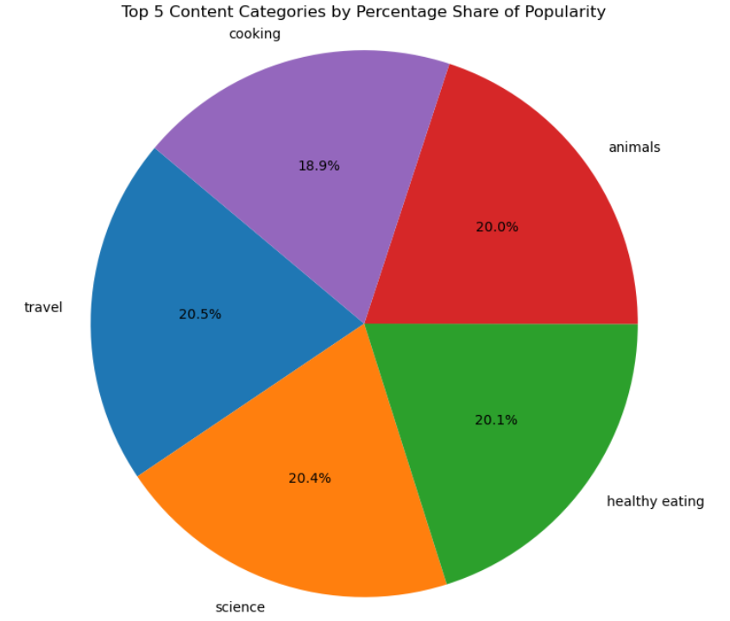

Slide 10


In our presentation to Social Buzz, we highlighted crucial insights and recommendations to support their growth and IPO readiness.
We identified the top 5 content categories based on popularity scores, providing actionable insights to optimize content strategy and user engagement.
Our audit of their big data practices aimed at enhancing scalability and efficiency, recommending advanced technologies and best practices.
Moving forward, our partnership aims to implement these recommendations, ensuring Social Buzz is well-equipped for sustained growth in the competitive social media industry.
Summary

Slide 11

Thank you!
ANY QUESTIONS?

